Slide 1
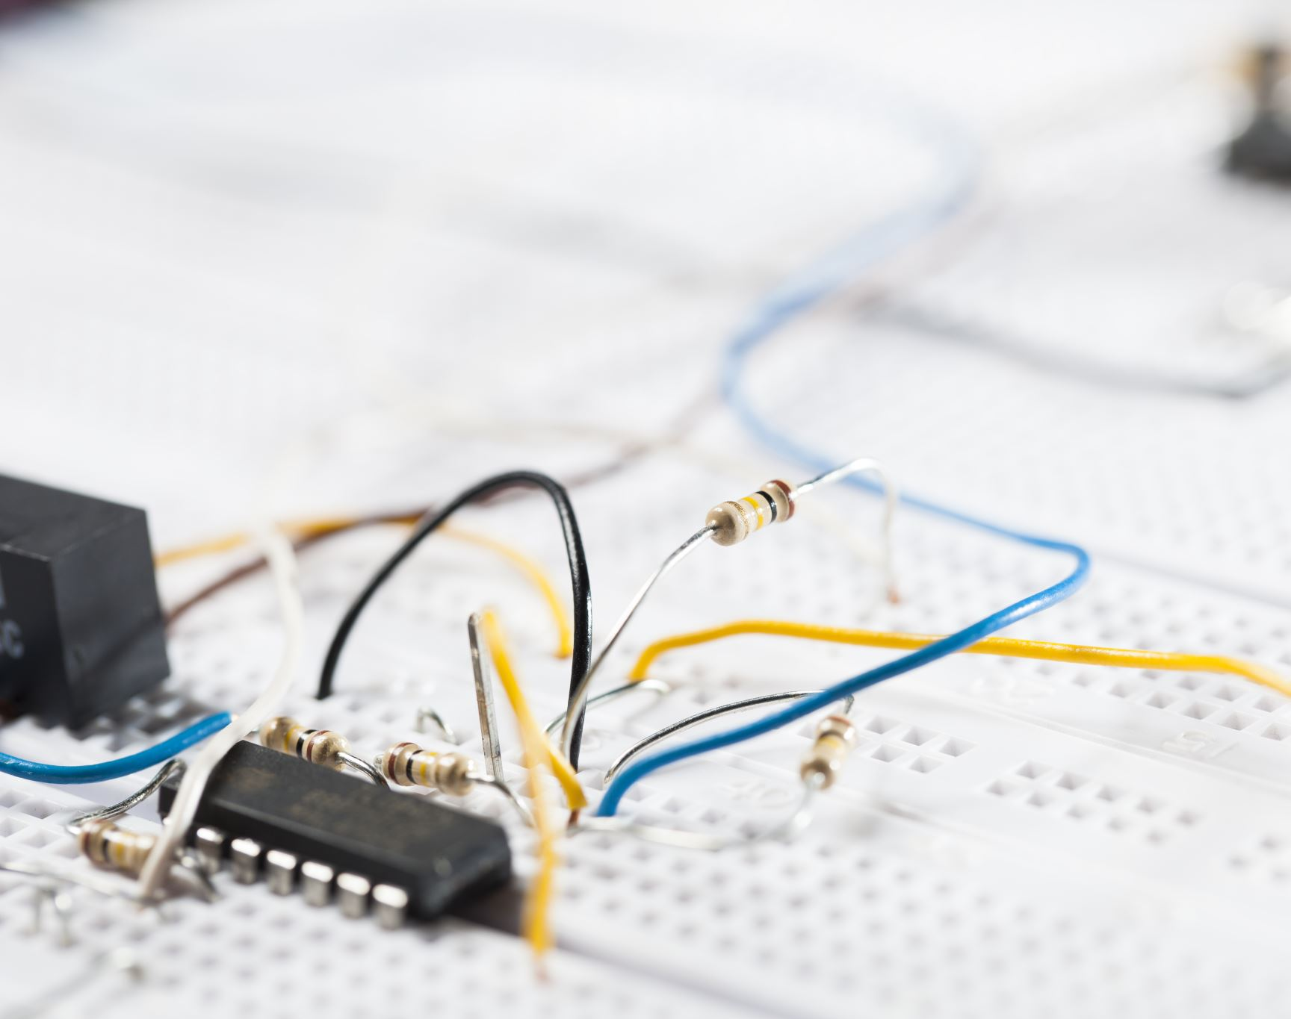
Real-Time Face Mask Detection System with Arduino-Controlled Access.

Slide 2
Team members
Jaden Daniel(RA2211003011328)
Badrinarayanan(RA2211003011356)
T Sri Rangasuthan(RA2211003011319)
Naman Middha(RA2211003011311)

Slide 3
Introduction
Welcome to our presentation on "Real-Time Face Mask Detection System with Arduino-Controlled Access."
In response to the ongoing challenges posed by the COVID-19 pandemic, we have developed an innovative solution that combines real-time face mask detection with Arduino-controlled access for enhanced safety and security.
Our project integrates computer vision, deep learning, and Arduino microcontroller technologies to create a comprehensive system capable of detecting face masks in real-time and controlling access to designated areas based on mask compliance.
This presentation will provide an overview of our system's architecture, components, functionality, and implementation process, highlighting the seamless integration of hardware and software components.
Join us as we explore how our solution addresses the urgent need for effective mask detection and access control measures in various environments, contributing to public health and safety efforts worldwide.

Slide 4
Objective
The primary objective of our project is to develop a comprehensive real-time face mask detection system integrated with Arduino-controlled access.
Real-Time Face Mask Detection: Implementing a robust face detection algorithm capable of identifying individuals and determining whether they are wearing a face mask.
Arduino-Controlled Access: Utilizing Arduino microcontroller technology to control access to designated areas based on mask compliance, ensuring only individuals wearing masks are granted entry.
Enhanced Safety and Security: Enhancing safety and security measures in various environments, such as public spaces, workplaces, and educational institutions, by enforcing mask-wearing policies and restricting access to non-compliant individuals.
Through the successful achievement of these objectives, our project aims to contribute to public health initiatives, mitigate the spread of infectious diseases, and promote safer environments for individuals worldwide.

Slide 5

Components
Computer or Raspberry Pi:
A computer or Raspberry Pi will serve as the processing unit to run the face detection and mask detection algorithms. It will also communicate with the Arduino board to control access based on the detection results.
Power Supply:
A stable power supply will be necessary to ensure continuous operation of the system, providing power to the Arduino board, servo motor, and other components.
Enclosure and Mounting Hardware:
Enclosure and mounting hardware will be used to house and secure the components in the desired location, ensuring durability and stability of the system.
Software Development Tools:
Various software development tools such as Python, OpenCV, TensorFlow, and Arduino IDE will be used to develop, test, and deploy the system. These tools will facilitate the integration of hardware and software components to create a seamless solution.

Slide 6
Components
Face Detection and Mask Detection Models:
Utilize pre-trained deep learning models for face detection and mask detection. These models will be responsible for identifying faces in real-time video streams and determining whether individuals are wearing masks.
Arduino Microcontroller:
Arduino microcontroller will serve as the central control unit for the project, responsible for interfacing with sensors, actuators, and processing data to make decisions based on mask detection results.
Servo Motor:
A servo motor will be used to control physical mechanisms such as doors or locks based on the mask detection outcome. It will rotate to either allow or deny access to individuals depending on their mask-wearing status.
Web Camera:
A web camera will capture real-time video footage, which will be processed by the face detection and mask detection models to determine mask compliance.

Slide 7
Operation
Overview:
The operation of our system involves the coordinated functioning of various components to achieve the goal of automated mask detection and access control. This slide elucidates the operational workflow and key steps involved in the system's functioning.
Initialization:
The operation begins with the initialization of the system, where all components are initialized, including the camera, face detection model, mask detection model, and Arduino board.
Video Stream Capture:
The system continuously captures the video stream from the camera in real-time. The video stream serves as input for face detection and subsequent processing.
Face Detection:
Using a pre-trained deep learning model, the system detects and localizes faces within the video stream. Detected faces are extracted and passed to the mask detection module for further analysis.

Slide 8
Operation
Mask Detection:
The extracted faces are analyzed by the mask detection model to determine whether individuals are wearing masks or not. The model assigns a probability score indicating the likelihood of mask presence.
Decision Making:
Based on the output of the mask detection model, a decision is made regarding the mask status of individuals. If a mask is detected, the system proceeds to unlock the access mechanism; otherwise, access remains restricted.
Servo Control:
The Arduino-based servo control system receives commands based on the mask detection result. If a mask is detected, the servo rotates to unlock the access mechanism, allowing entry. In the absence of a mask, the servo remains in a locked position.
Real-Time Feedback:
Throughout the operation, real-time feedback is provided to users regarding the mask detection result and access status. Visual indicators and alerts notify individuals of the system's decision, promoting compliance with mask-wearing protocols.
Continuous Monitoring:
The system operates continuously, monitoring the video stream and updating the mask detection result in real-time. Continuous monitoring ensures prompt response to changes in the environment and maintains the integrity of the access control mechanism.

Slide 9
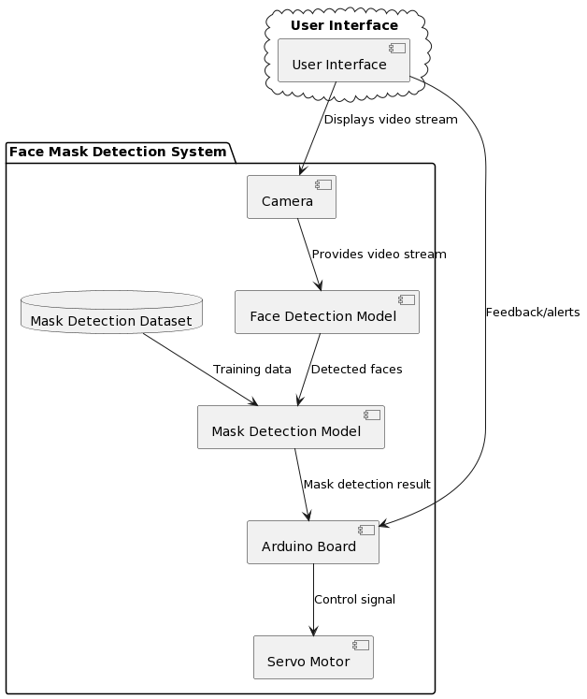
Architecture

